Slide 1
FINAL FLUTTER MOBILE APPLICATION
Excelerate Learning Hub
Taiwo Jeje · Team 4

Slide 2
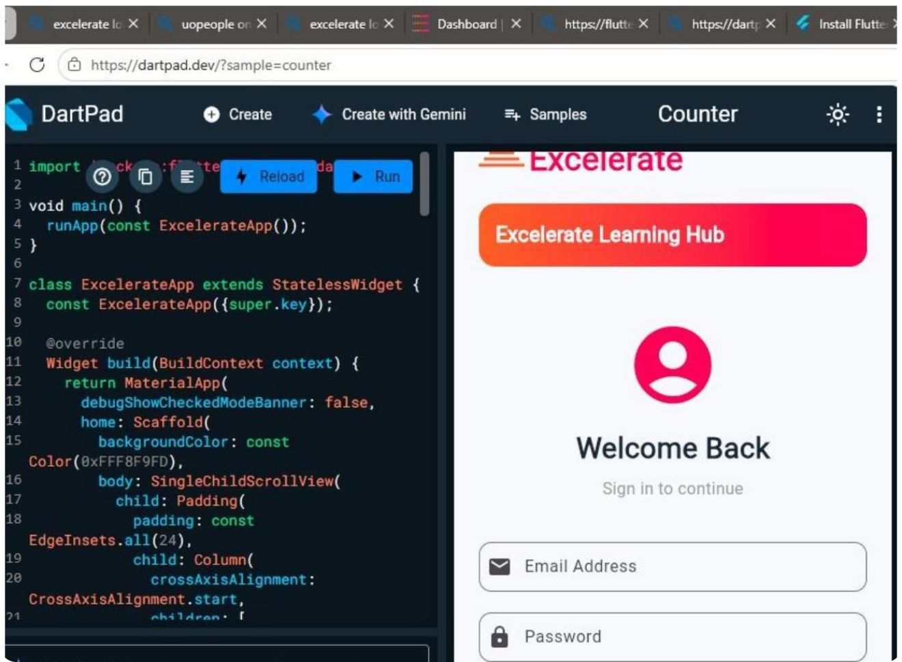



THE PRODUCT
A simple hub for finding opportunities
One mobile experience brings discovery, program information, and feedback into one clear place.
Discover learning opportunities
Access program information
Submit feedback through a simple mobile experience

Slide 3
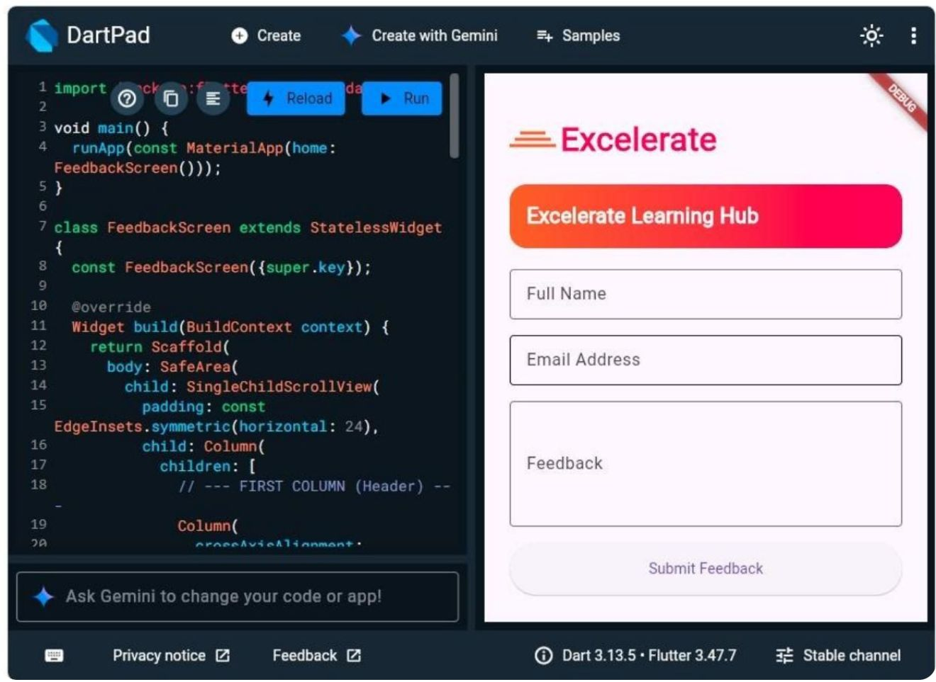
THE EXPERIENCE
Five core screens carry the experience
Each screen has a focused role in helping users move from access to action.
01
02
03
Login
Home dashboard
Program listing
04
05
Program details
Feedback form

Slide 4
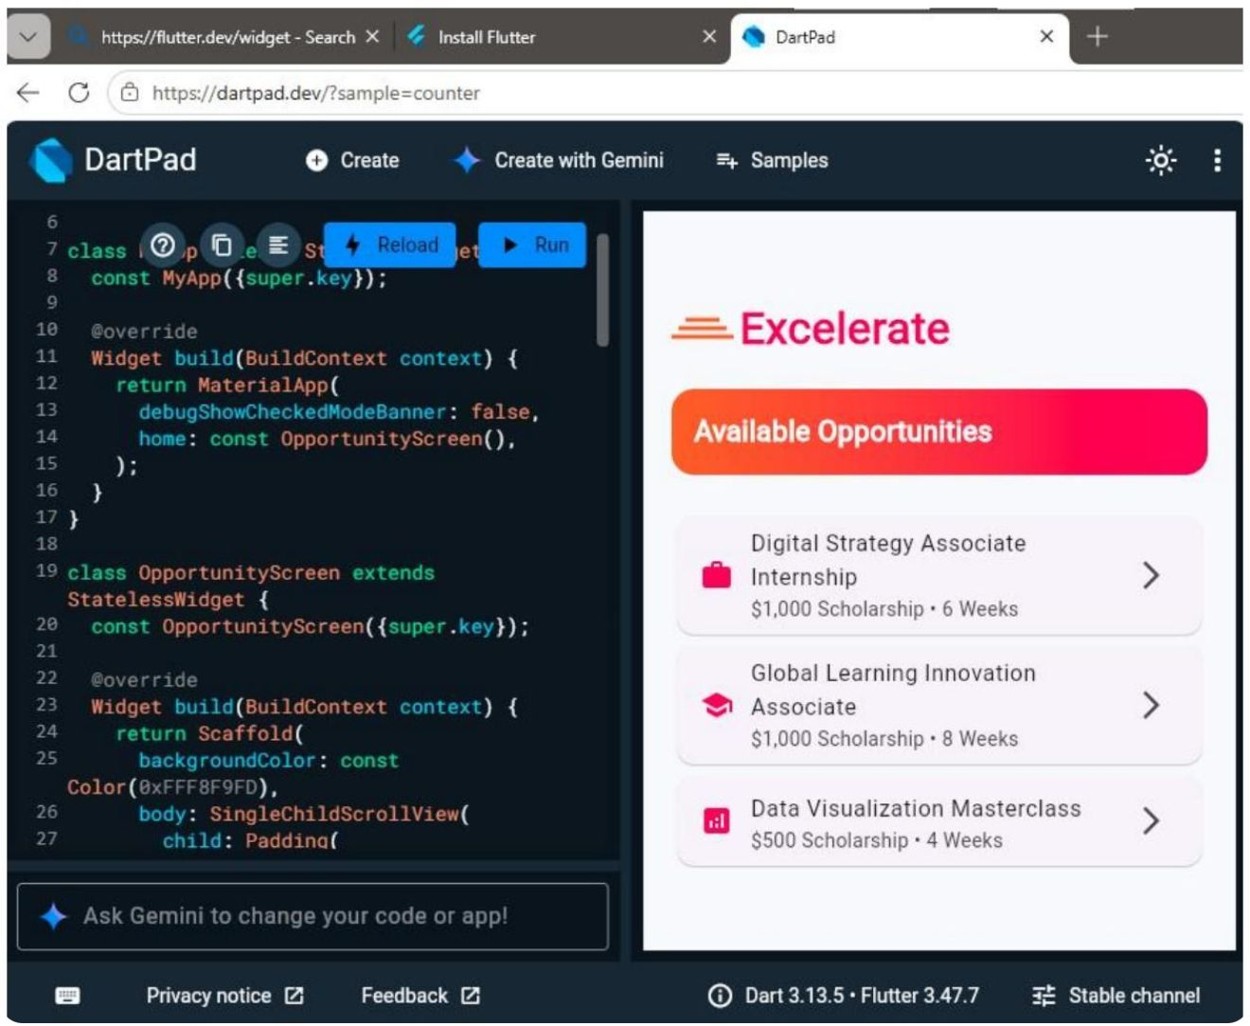
THE USER JOURNEY
The journey is clear from login to feedback
Login
Explore the home dashboard
Browse available programs
Open program details
Submit feedback

Slide 5
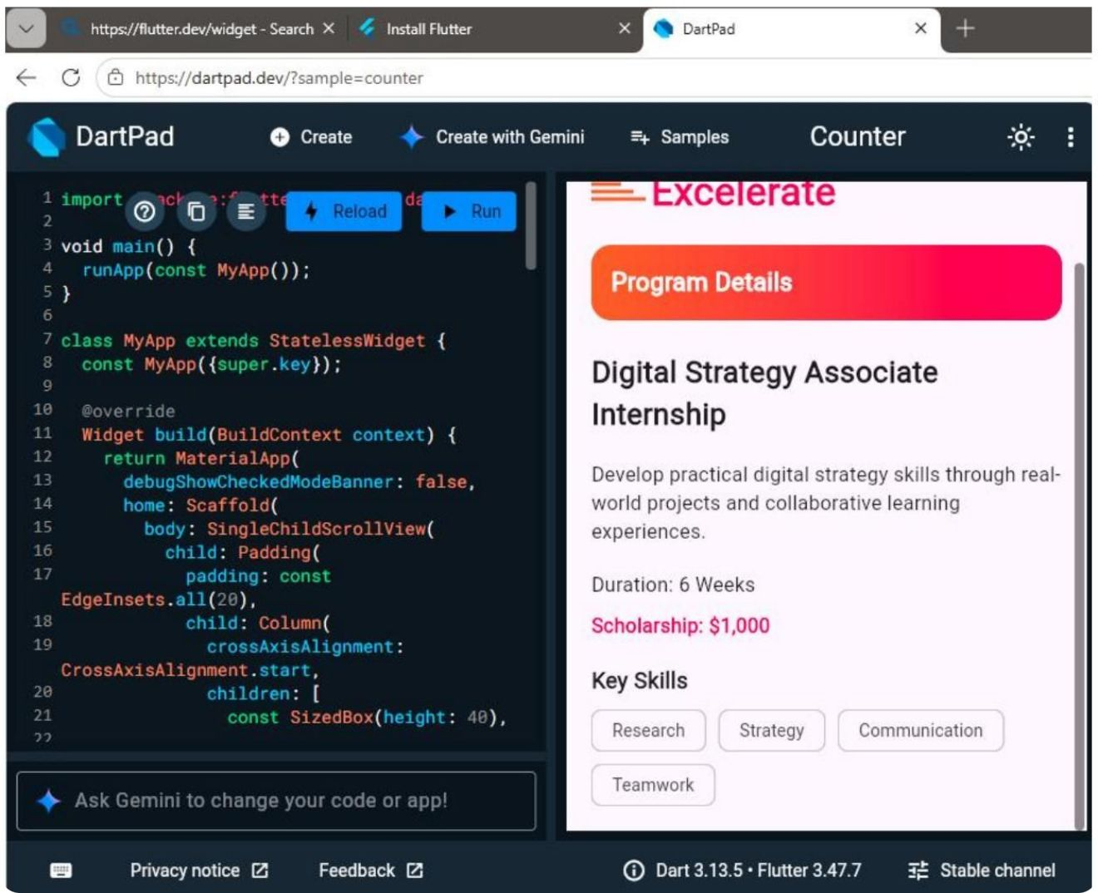
DATA FLOW
Programs are loaded dynamically
01
02
03
Program model + program service
JSON data integration
Responsive listing and details views
Program content is loaded dynamically.
Programs are structured for consistent access.
The same data supports both views.

Slide 6
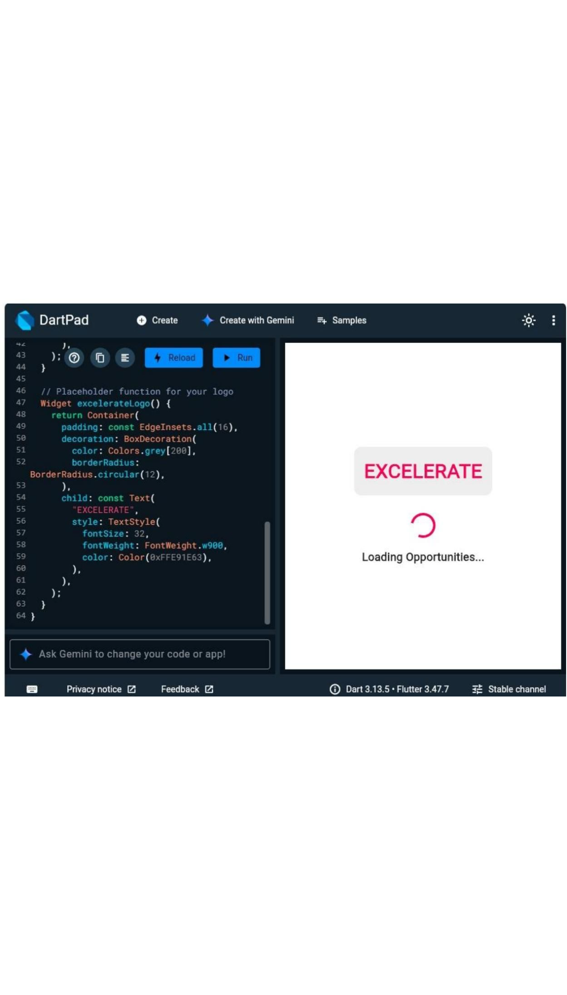
BETWEEN THE SCREENS
Good UX includes the moments between screens
Loading and skeleton states
The interface stays clear while content loads.
Success confirmation after submission
Users know when feedback is complete.
Error handling with retry functionality
Users can recover when something goes wrong.

Slide 7
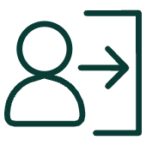



BUILDING THE PRODUCT
Flutter skills became a working product
Authentication and navigation
State management with setState()
Form validation and submission workflow
Testing, debugging, and data handling

Slide 8
Complete Flutter source code
README documentation and setup instructions
DELIVERY
The app is portfolio-ready
Screenshots, changelog, and commit history
Repository
github.com/Deji-Oladiran/Taiwo-Gbenga-Jeje.git

Slide 9
DEMO EVIDENCE
What the demo proves
01
02
03
Login flow works end to end
Programs can be browsed and opened
Feedback can be validated and submitted
04
Success confirmation closes the loop

Slide 10
WEEK 4 DELIVERABLE
From fundamentals
to a complete app
Strengthened Flutter development, state management, dynamic data integration, validation, testing, and GitHub documentation.
Next steps: real API integration, stronger authentication, and push notifications.
Taiwo Jeje · Team 4

